Slide 1
Topic: Interest
EQ: What is the concept of simple interest?
Get your VIVO’s
Caleb, Connor, Nathan, Alex, Harvey, Caleb – for 100% on test
More to give today if you want- Do your 100%, don’t distract

Slide 2
Topic: Interest
EQ: What is the concept of simple interest?
If you put money into a bank or building society they will pay you interest on this money.
If you have borrowed money, from a bank or building society for a mortgage or other loan, you have to pay them interest.
Simple interest is calculated on a yearly basis (annually) and depends on the interest rate. The rate is often given per annum (p.a.) which means per year.

Slide 3
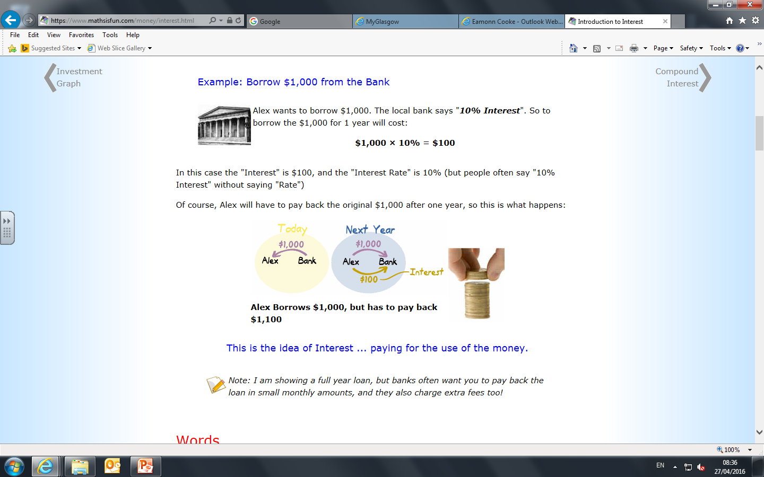
Topic: Interest
EQ: What is the concept of simple interest?
Alex wants to borrow $1,000. The local bank says "10% Interest". So to borrow the $1,000 for 1 year will cost:
$1,000 × 10% = $100
In this case the "Interest" is $100, and the "Interest Rate" is 10%
Of course, Alex will have to pay back the original $1,000 after one year, so this is what happens:
This is the idea of Interest ... paying for the use of the money.

Slide 4
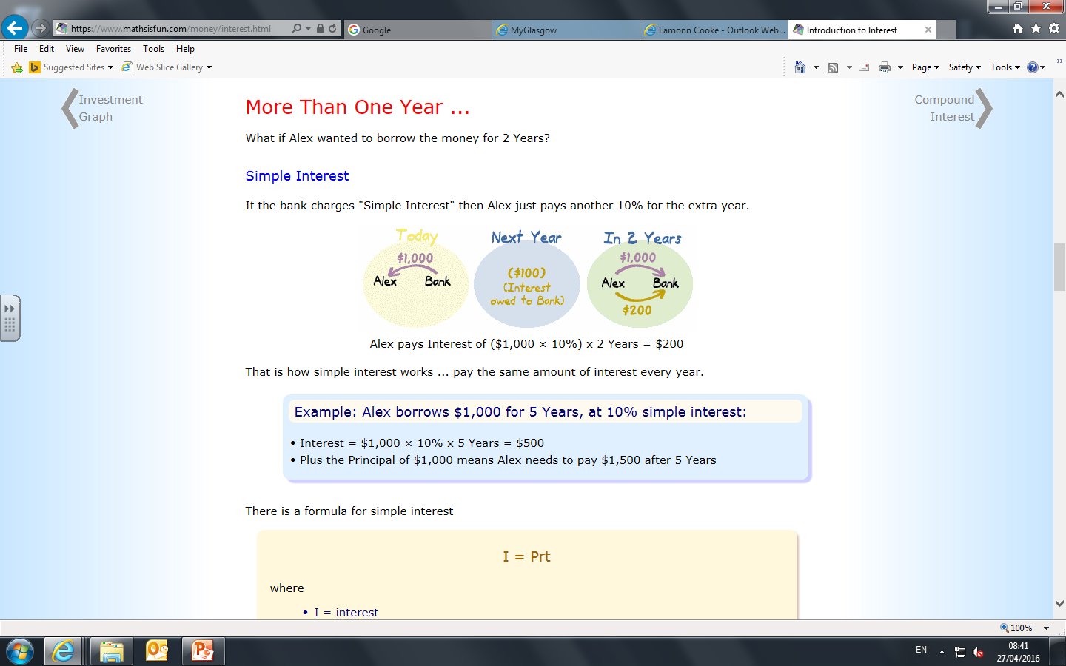
Simple Interest-More than a year
If the bank charges "Simple Interest" then Alex just pays another 10% for the extra year.
Alex pays Interest of ($1,000 × 10%) x 2 Years = $200
That is how simple interest works ... pay the same amount of interest every year.

Slide 5

Example
Sally deposits $600 into an account with an interest rate of 5% per annum.
Calculate the interest that Sally receives in one year and find how much money she has in the account after one year.
Interest = 5% of $600
100% + 5% = ?
$600 +5% = ?
5% = 5/100 (Multiplier)
5/100 of $600
= $30
New balance = $600 + $30
= $630
Is there a quicker way?

Slide 6
Phrase % Multiplier
5 % increase
1.005
10 % increase
1
15 % increase
1.15
½ % increase
1.1
No change
1.05

Slide 7
Example
A car depreciates at rate of 30%. Initially it cost $25,000.
How much will it be worth after a year?
Decrease: 100 - 30 = 70%
70% of $25,000
10%= $2500
70% = $17,500
Is there a quicker way?

Slide 8
Phrase % Multiplier
0.5
1 % decrease
0.965
0.85
3.5 % decrease
1
15 % decrease
50 % decrease
0.99
No change

Slide 9
Topic: Interest
EQ: What is the concept of simple interest?
 | Simple interest is an amount of money that you earn as a flat amount Simple interest has 3 parts: Principle (p) Interest rate – as a decimal (r) Time (t) Simple interest is calculated as SI=P x R x T

Slide 10
Practise
Have a go at finding the Simple interest on the following amounts
Principle | Interest (%) | Years | Interest amount
2,500 | 12.5 | 6
40,000 | 5 | 20
150,000 | 6.5 | 13
1,250,000 | 15% | 0.5

Slide 11
Practise
Have a go at finding the Simple interest on the following amounts
Principle | Interest (%) | Years | Interest amount
2,500 | 12.5 | 6 | $1, 875
40,000 | 5 | 20 | $40, 000
150,000 | 6.5 | 13 | $126, 750
1,250,000 | 15 | 0.5 | $93, 750

Slide 12
Find the Gross amount of the following
Principle | Rate | Years | SI | Gross (SI+P)
45000 | 10% | 3
260,000 | 8% | 10
470,500 | 6.66% | 25

Slide 13
Find the Gross amount of the following
Principle | Rate | Years | SI | Gross (SI+P)
45000 | 10% | 3 | 135,000
260,000 | 8% | 10 | 208,000
470,500 | 6.66% | 25 | 783,382.5

Slide 14
Find the Gross amount of the following
Principle | Rate | Years | SI | Gross (SI+P)
45000 | 10% | 3 | 135,000 | 585,000
260,000 | 8% | 10 | 208,000 | 468,000
470,500 | 6.66% | 25 | 783,382.5 | 1,253,882.5

Slide 15
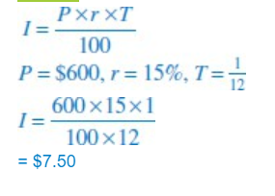
Topic: Interest
EQ: What is the concept of simple interest?
 | Change in time periods
The ticketed price of a mobile phone is $600. Andrew decides to purchase the phone using his credit card. After 1 month the credit card company charges interest at a rate of 15% p.a. Calculate the amount of interest that Andrew must pay on his credit card after 1 month.

Slide 16
Topic: Interest
EQ: What is the concept of simple interest?
 | Complete Quick 5 simple interest worksheet

